Slide 1
Aspen Simulation: Haber-Bosch Process
CHBE446
PhucLam Dinh, Matthew Hogan, Kaden Kovarcik, Ivan Lin, Jefferson Van

Slide 2
Overview
Reaction Theory
  Steam Reforming
  Haber-Bosch Process
Property Equations
  Methods
  Kinetics
Aspen Worksheets
  Main Flowsheet
  Block Specifications
  Stream Results

Slide 3
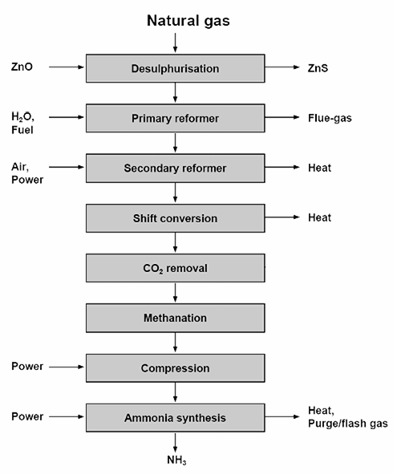
Overall Process
AspenTech

Slide 4
Steam Reforming
Two main reactions to produce hydrogen:
Steam Reforming (SR):
Highly endothermic
Water-Gas Shift Reaction (WGSR):
Slightly exothermic
Steam reforming - Wikipedia
Notes:
The exothermic nature of the WGSR will be important later on during the design of the flowchart.

Slide 5
Haber-Bosch Process
Overall ammonia synthesis reaction:
N₂​(g) + 3H₂​(g) ⇌ 2NH₃​(g) ΔH=−92.4 kJ/mol
3:1 Hydrogen to Nitrogen Ratio

Slide 6
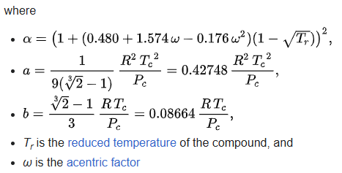

Methods
Base method: Redlich-Kwong-Soave EOS w/ Boston-Mathias modification (RKS-BM)
  Useful for process simulations at high pressures (Haber-Bosch: 150-300 bar)
  Soave and Boston-Mathias modifications add additional temperature-dependent corrections
Redlich–Kwong equation of state - Wikipedia

Slide 7
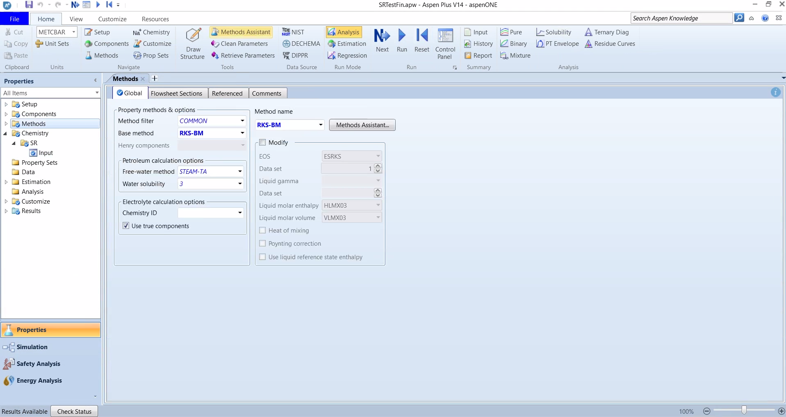
Methods - Aspen Input

Slide 8

Kinetics
Van’t Hoff Equation was used for all three reactions
 | A | B | C | D | E | Temp App. (C)
SR | -1.586 | 1569.6 | -0.5383 | -0.0016 | -1.176e-06 | 900
WGSR | 6.179 | -1899 | 0.1184 | -0.001157 | -407900 | 300
HB | -19.66 | 9727.0 | 3.775 | -0.0000021 | -1.4e8 | 400
AspenTech

Slide 9
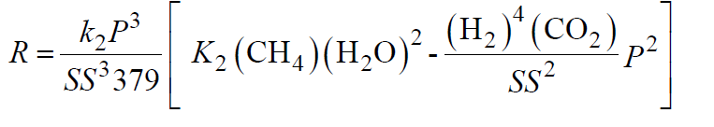
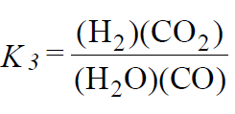
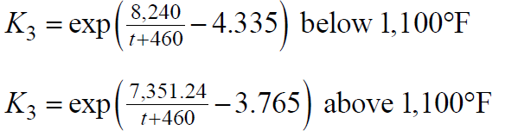
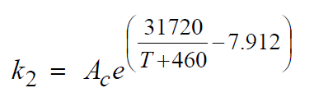
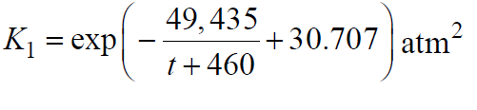

Slide 10
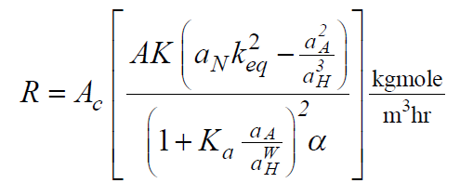
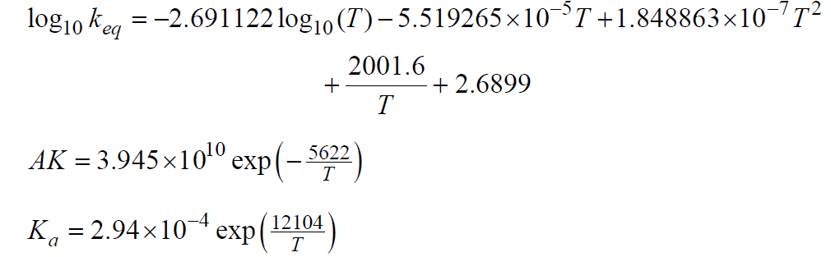
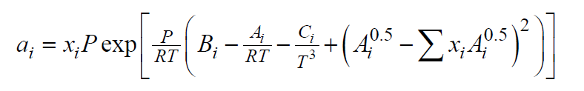

Slide 11
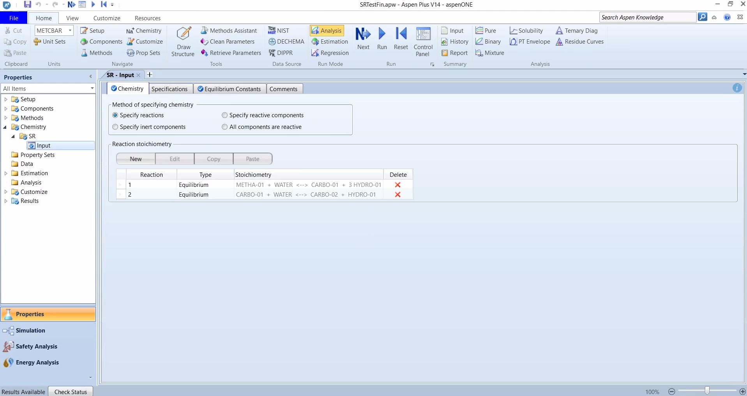
Reactions - Aspen Input

Slide 12
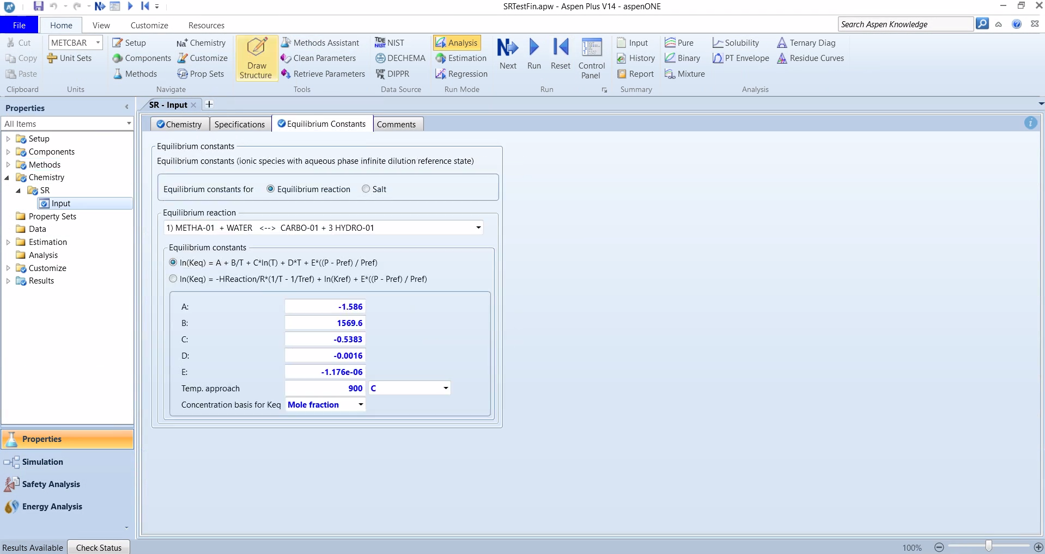
Kinetics - Aspen Input

Slide 13

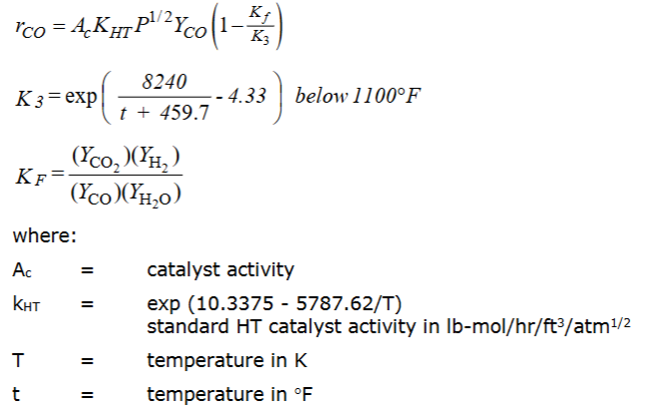


Kinetics - Custom Equations
Kinetic expressions for steam reforming (above) and high temperature shift conversion (right).
AspenTech
Notes:
These were the kinetic expressions given in the AspenTech document and the ones that the authors used the fortran subroutines for (that we cannot use).
As can be seen, they don’t look like the power law expressions we are accustomed to, so I decided to set up Custom equations under the Reactions folder in Aspen. I used an example file from Design 1 to guide some of the input for the parameters. Other things were just guessed.

Slide 14
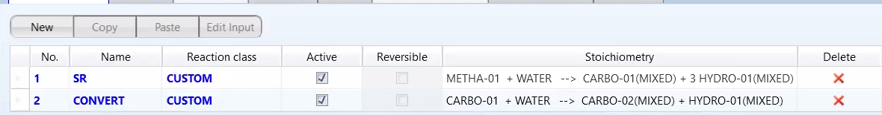
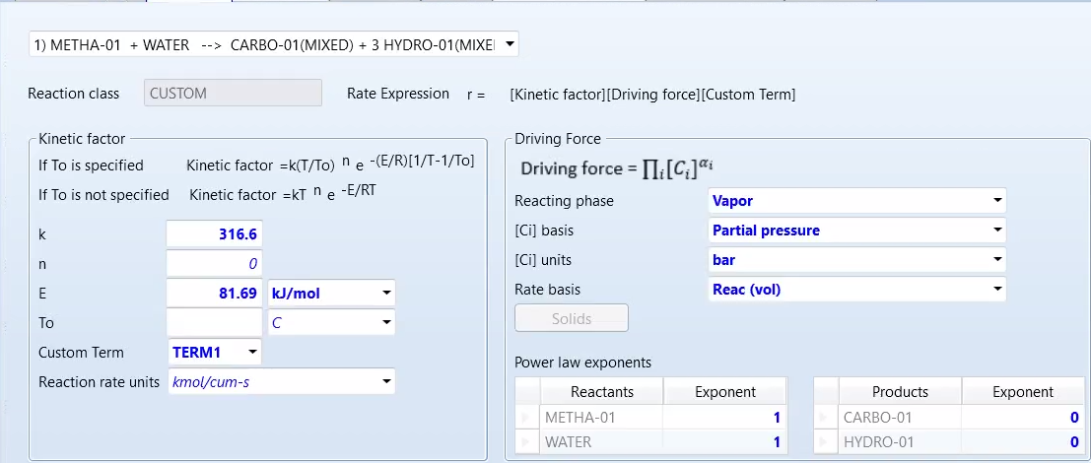
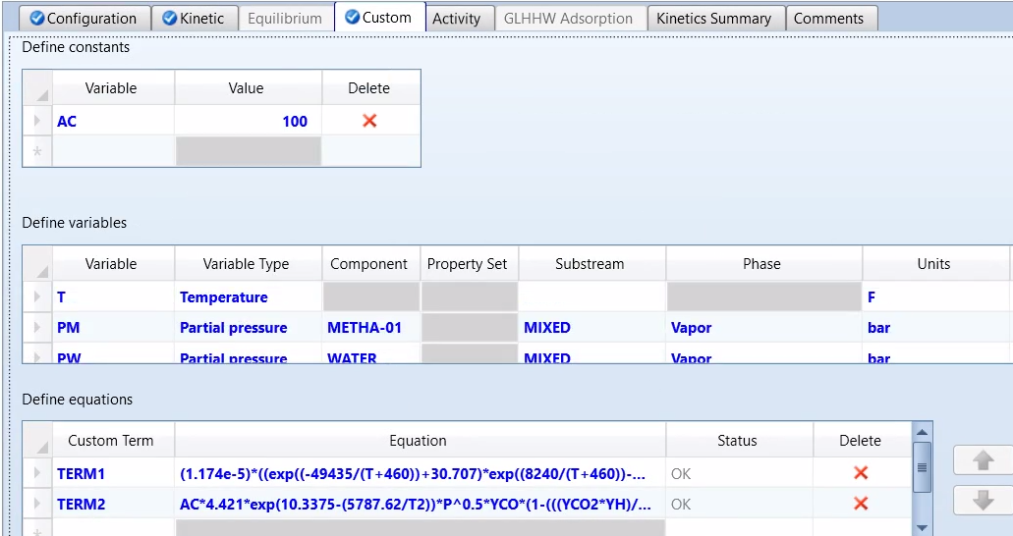
Kinetics - Custom Equations
Chen et al. (2020) International Journal of Hydrogen Energy
Notes:
After clicking on Reactions and starting a new set, Aspen will ask for chemical equations and the stoichiometry. The tab “Kinetic” then asks you to input a kinetic factor (left section) and driving force (right section). You have to do this for each reaction in the set.
I took the kinetic factor as just the rate constant of the reaction. K is the pre-exponential factor (I think) and E is the activation energy (I think). For these values, I used the source at the bottom of the slide to find example values since AspenTech just gave an expression.
For the driving force, I used the settings from the Design 1 example file. I’m not sure if all of it is correct. Since everything happens in the vapor phase, I used partial pressure. In terms of the rate basis, it should probably be based on catalyst weight, but for the sake of time, I stuck with the default reactor volume setting. Same issue with the stoichiometric coefficients.
For custom equations, I took it as is. Constants go in the top section. Variables (pressure, temperature, mole fractions) go in the middle section. The actual custom term goes in the “Define equations” section. I substituted all of the expressions I could into the main kinetic expressions and then typed them in. After typing them in, you have to go back to the kinetic tab and select the correct custom term for each reaction.
The steam reforming reaction uses the first custom term while the CO conversion reaction uses the second term. This is just for the steam reforming section of the flowchart. The CO conversion section uses other reaction sets. In total, there are 3 sets: Reforming, High Temperature (HT) shift, and low temperature (LT) shift.
I think for the kinetics, Aspen uses kinetic factor x driving force x custom term

Slide 15
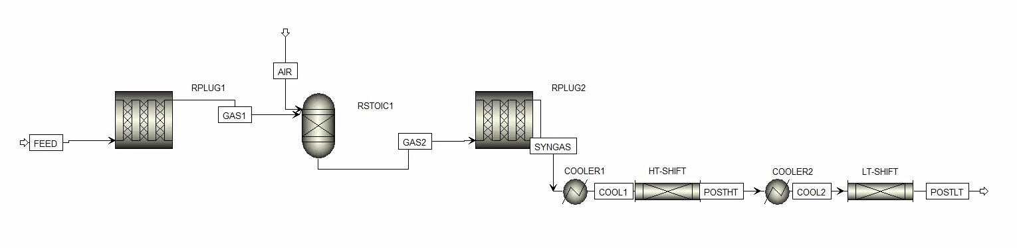
Main Flowsheet - Steam Reforming
Steam Reforming: RPlug1, RStoic1, RPlug2
Water-Gas Shift Reaction: HT-Shift, LT-Shift
Steam reforming - Wikipedia
Notes:
The first three units are for steam reforming, the last four (2 coolers, 2 PFRS) are for CO conversion.
I tried to replicate what the example Ammonia file used.
The Ammonia file used 2 Rstoic and 2 RPlug for steam reforming. 2 Rplug, 2 coolers, a heat exchanger, and split and mix points for CO conversion. I’m not entirely sure why it was so complicated. Maybe for saving energy or regulations or something.
From what I observed, the Rstoic in the steam reforming section is used to generate more steam from the hydrogen we produced and the fresh oxygen in the Air stream. This helps push the reaction forward and produce even more hydrogen than we would have otherwise got in RPlug2 (Le chatelier’s principle maybe, take from products, add to reactants). In the results, moles of hydrogen goes from 3300 (after RPlug1) to 2600 (after Rstoic) and then to 3600 (after RPlug2).
For the CO conversion, the first PFR is at high temperature. This takes advantage of fast reaction rates but won’t achieve full conversion due to Le Chatelier’s principle. As heat accumulates (adiabatic reactor), the forward direction for hydrogen production becomes unfavorable. After going through cooling, the Low Temperature PFR completes the conversion to give maximum hydrogen and minimal CO remaining.

Slide 16
Block Specifications - Steam Reforming
COOLER1: 380 C, 28.7 bar
COOLER2: 210 C, 27.8 bar
HT-SHIFT: Adiabatic, 15.8 m length, 2.2 m diameter
LT-SHIFT: Adiabatic, 7.7 m length, 3.7 m diameter
RPLUG1: 791 C, 10 m length, 0.14 m diameter
RPLUG2: 978 C, 4.73 m length, 3 m diameter
RSTOIC1: 1257 C, 30.7 bar
AspenTech
Notes:
These specifications came from the example Ammonia file as well. Could probably use different settings and get somewhat similar results. Make sure they are high temperature and high pressure.

Slide 17
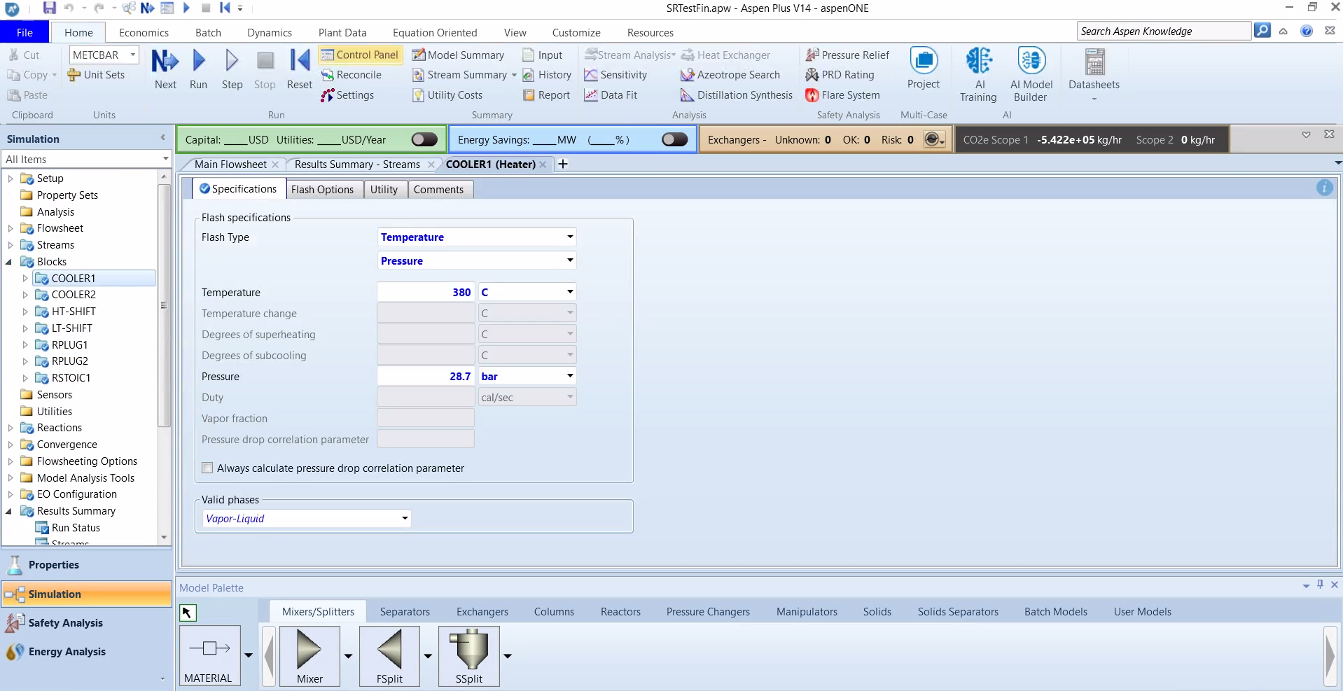
Block Specifications - Aspen Input

Slide 18
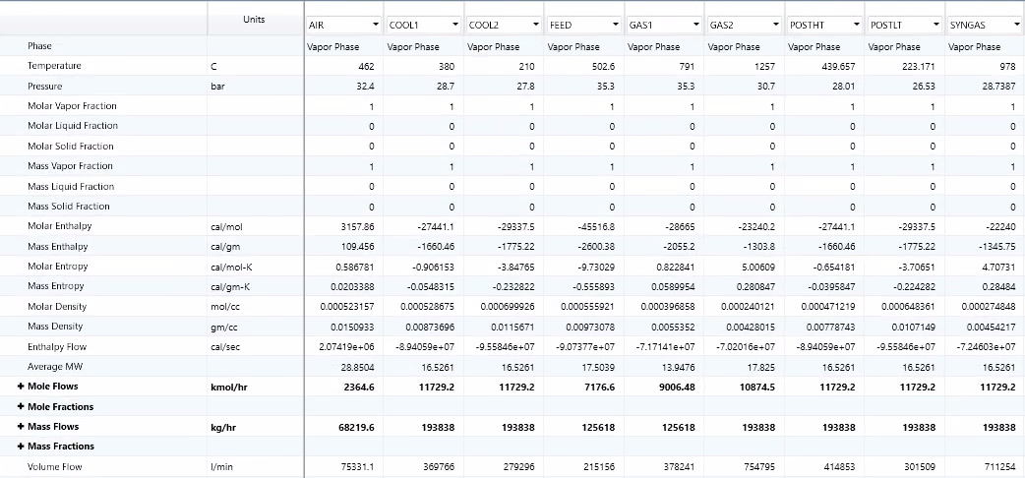
Stream Results - Steam Reforming

Slide 19
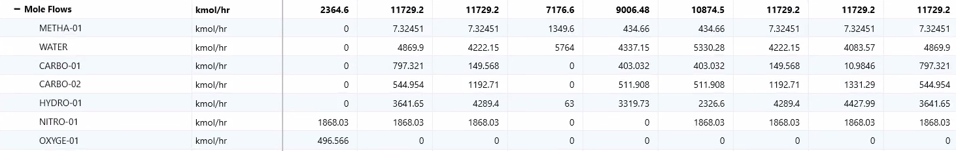
Stream Results - Steam Reforming
SYNGAS stream has an accumulation of carbon monoxide.
POSTLT product stream contains extracted hydrogen gas with minimal methane or carbon monoxide remaining.
Notes:
Can maybe say the speaker notes from slide 13 here instead.
SYNGAS is the immediate result of only steam reforming.
Compare SYNGAS and POSTHT to show the importance of carbon monoxide conversion for producing more hydrogen (and how a lot of CO is converted with just the High Temp PFR).
Compare POSTHT and POSTLT carbon monoxide content to show that the conversion is completed.

Slide 20
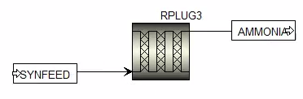
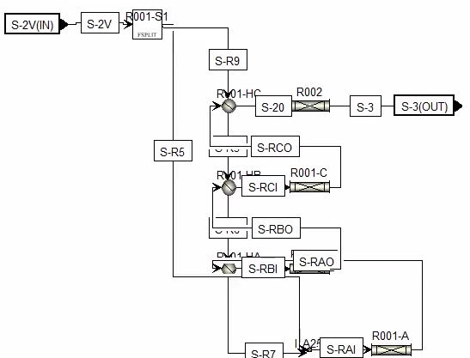
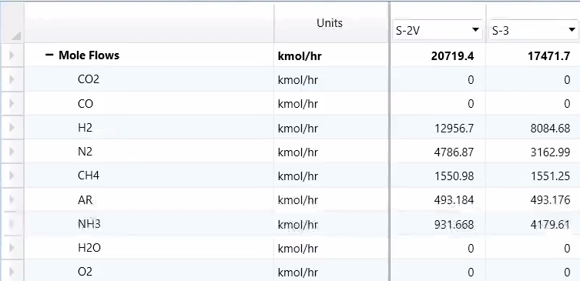
Main Flowsheet - Haber Bosch
Notes:
The ammonia synthesis portion of the flowchart I created failed. The bottom two images are from the example Ammonia file and should be what it looks like.
From what I observed, there seems to be a lot of recycling to increase yield of ammonia. Maybe even some added initial ammonia to “jumpstart” the process.

Slide 21
References
Aspen plus Ammonia Model; AspenTech.
MUNSTER, P. (1981). Kinetics of the steam reforming of methane with iron, nickel, and iron-nickel alloys as catalysts. Journal of Catalysis, 72(2), 279–287. doi:10.1016/0021-9517(81)90010-5
Mostafa El-Shafie. A Comprehensive Assessment of Ammonia Synthesis Reaction Kinetics and Rate Equations. International Journal of Hydrogen Energy 2023. https://doi.org/10.1016/j.ijhydene.2023.06.011.
Clark, J. The Haber Process. Chemistry LibreTexts. https://chem.libretexts.org/Bookshelves/Physical_and_Theoretical_Chemistry_Textbook_Maps/Supplemental_Modules_(Physical_and_Theoretical_Chemistry)/Equilibria/Le_Chateliers_Principle/The_Haber_Process.
Chen, K., Zhao, Y., Zhang, W., Feng, D., & Sun, S. (2020). The intrinsic kinetics of methane steam reforming over a nickel-based catalyst in a micro fluidized bed reaction system. International Journal of Hydrogen Energy, 45(3), 1615-1628. https://doi.org/10.1016/j.ijhydene.2019.11.080.
AspenTech. Aspen Plus: Aspen Plus Ammonia Model.
‌

